Slide 1
CLOTHES AND FASHION

Slide 2
Say a tongue twister as fast as you can:
Casual clothes are provisional for leisurely trips across Asia.
Answer the questions:
What clothes do you usually wear in cold day? At school? At home?
What clothes do you wear when you go somewhere special?

Slide 3
The TOPIC of our lesson is
CLOTHES AND FASHION

Slide 4
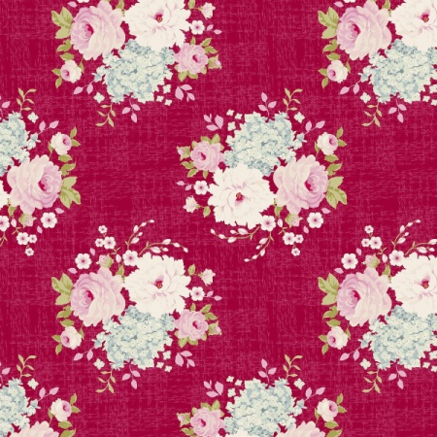
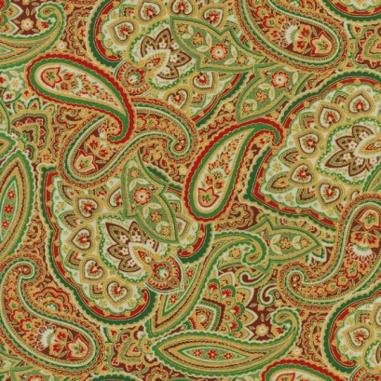
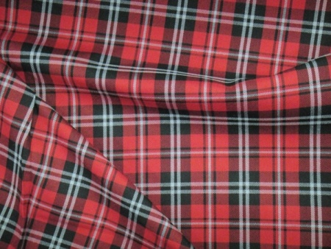
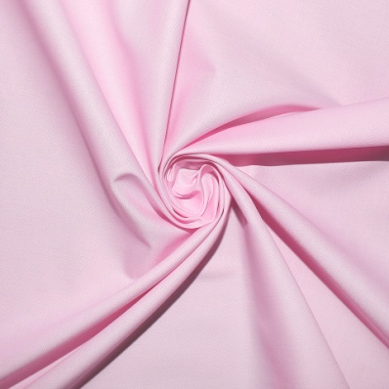
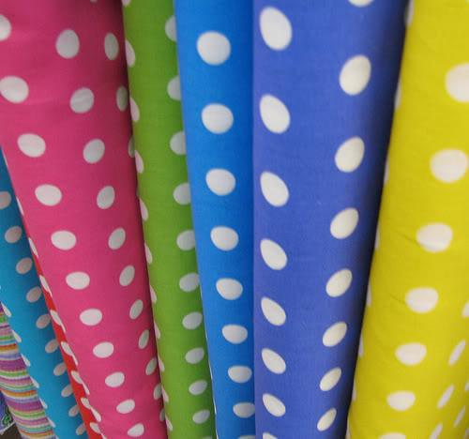
pattern
floral
patterned
checked
plain
striped
polka-dot

Slide 5
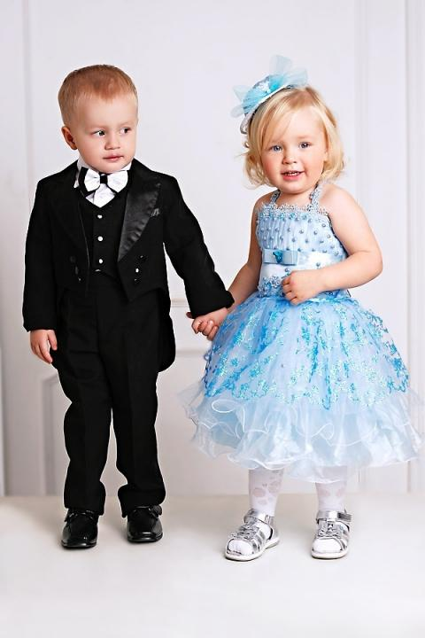
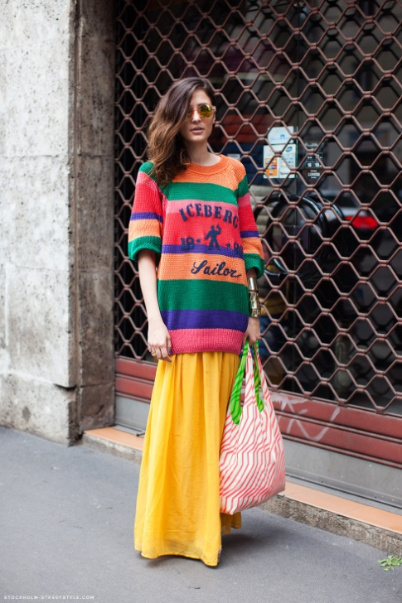
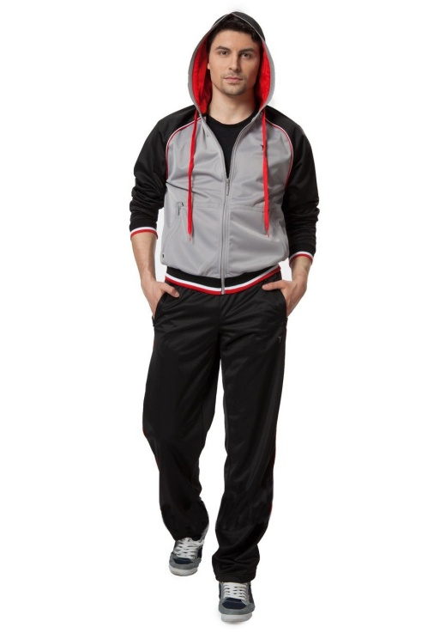
Style
smart
baggy
sporty
casual

Slide 6
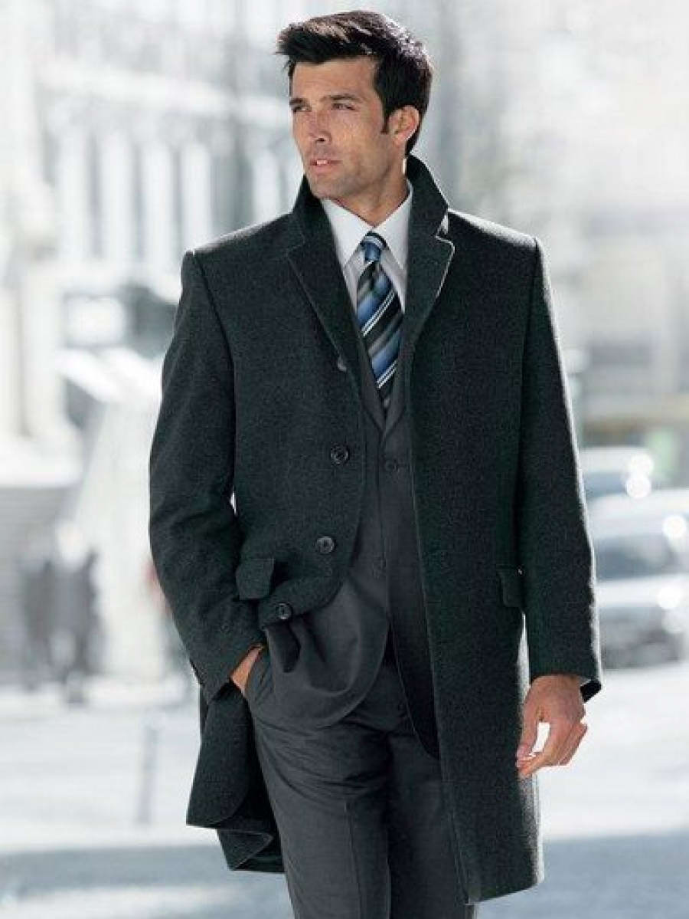
loose-
fitting
tight-
fitting
scruffy
elegant

Slide 7
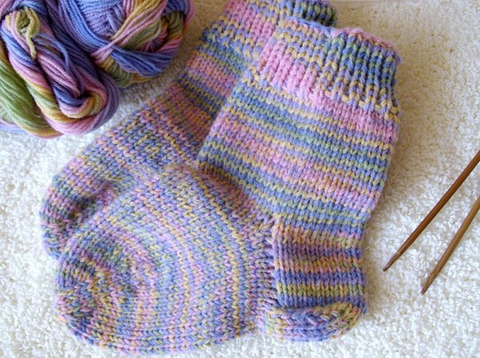
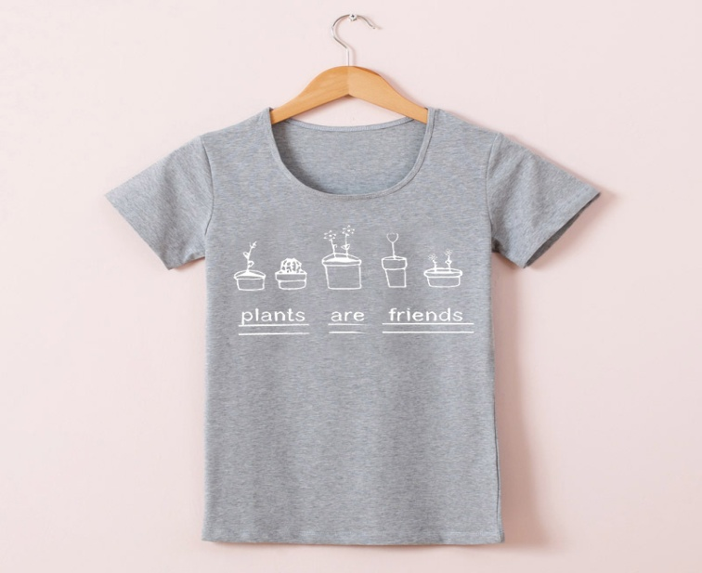
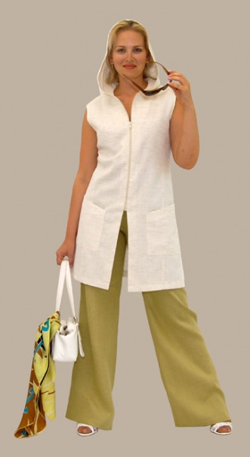
material
woolen
cotton
linen

Slide 8
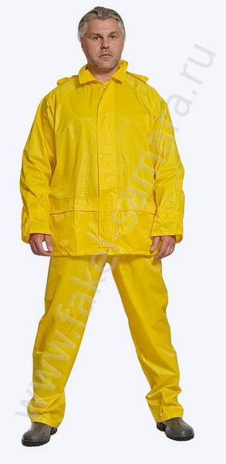
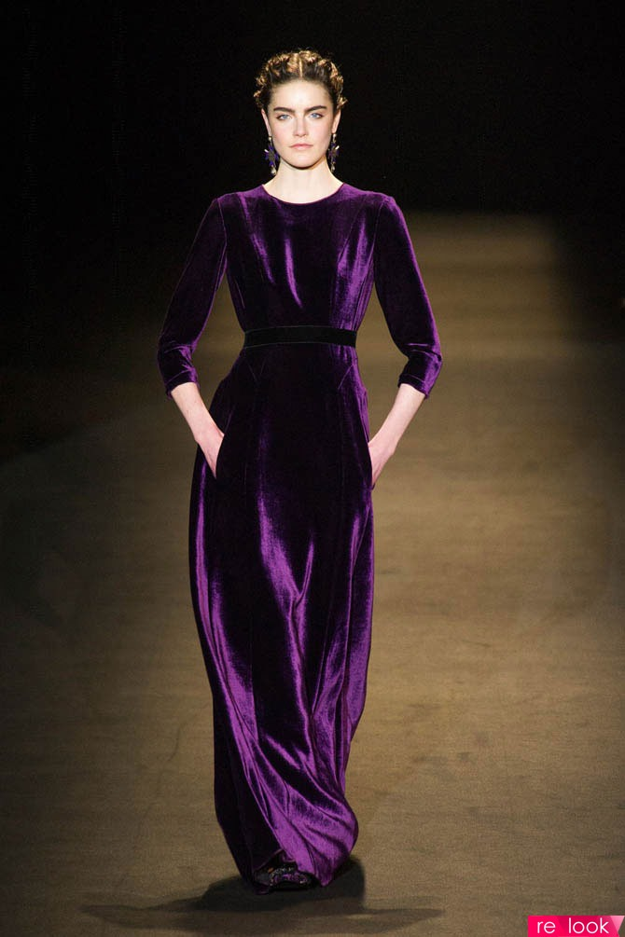
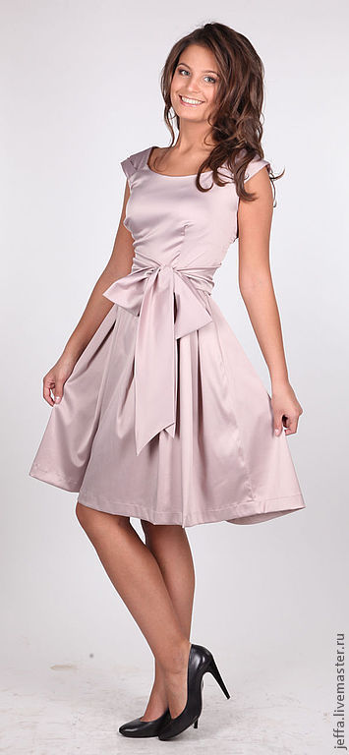
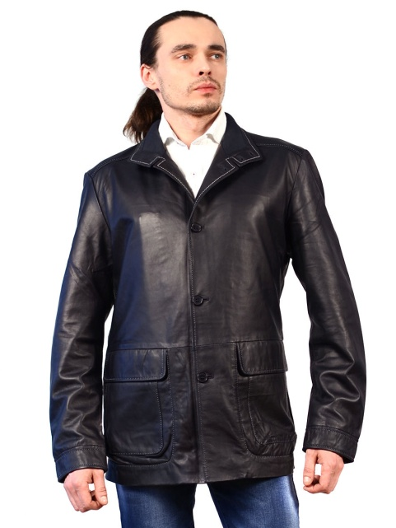
velvet
nylon
leather
silk

Slide 9
polka-dot
loose-fitting
elegant
velvet
silk
checked
tight-fitting
baggy
patterned
cotton
leather
woolen
linen
casual
plain
nylon
smart
sporty
scruffy
floral
striped
material
pap
pattern
style

Slide 10
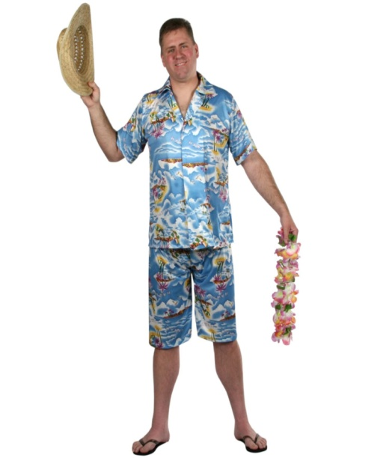
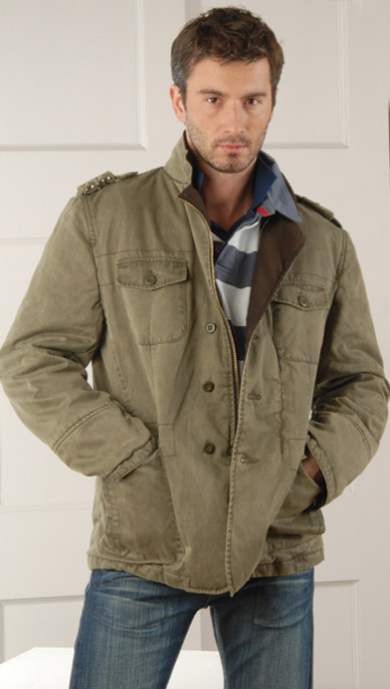
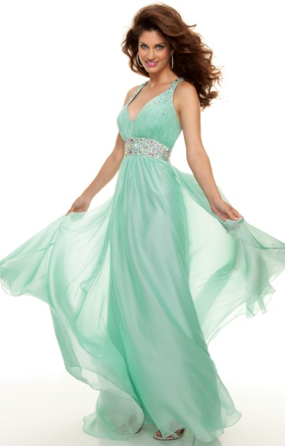
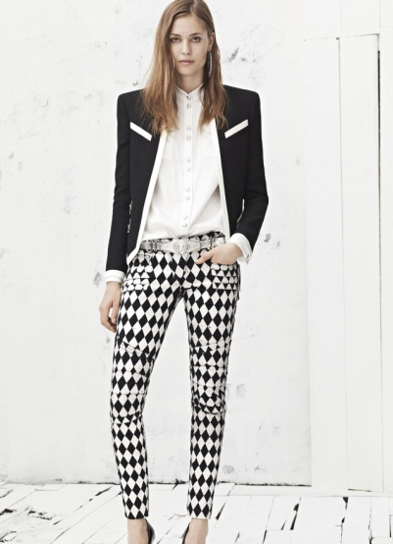
A
B
C
D
E
What do you think of these people’s clothes? Make sentences using the phrases:
looks(very)smart/classy/modern/trendy/casual/comfortable/
old- fashioned
Ex. The man in picture A looks funny. He is wearing a floral shirt and loose-fitting shorts.

Slide 11
Read the words:
to be the right shape or size for sth/sb
fit
suit
to make you look attractive
match
to go with – to combine well
to have sth on your body
body as a piece of clothing
wear
try on
to put a piece of clothing to see if it fits and how it looks
соответствовать по
(стилю, цвету, вкусу)
go

Slide 12
Use the correct form of each word to fill in the blanks: fit, match, suit, wear, try, go 1. A: How about those trousers? They……… you perfectly. B: Yes, but they’re too casual for the occasion. 2. A: What about the red shirt? It……….. your trousers. B: You’re right! I haven’t……… it for ages. 3. A: This dress is great. Why don’t you ……. it on? B: The colour doesn’t ……… me. 4. A: What do you think of this shirt? B: It doesn’t ……. with the trousers.

Slide 13
Lisa is going to a party. What is she going to wear? Listen, read and say. Read the dialogue and answer the questions. 1. Why is Lisa not ready yet? 2. Why doesn’t Clive approve of her first choice of outfit? 3. Why can’t Lisa wear her black trousers and velvet top? 4.Why does Clive decide not to wear his jeans?

Slide 14
Use the language in the box and the dialogue ex.6 p.61. Act out your dialogues. You are going to a party/theatre/ school/rock concert/gym/cinema. You can’t decide what to wear. You ask your friend for help.
Asking | Expressing approval
Do you like this? How’s this? What do you think of……? How do I look in this…….? | Excellent. It really……. It’s really nice. It really…. you.
 | Expressing disapproval
 | I don’t think it ….you. It’s too… I don’t like it. It’s a bit too…..

