Slide 1
Module 1 (Spotlight 7)

Slide 2
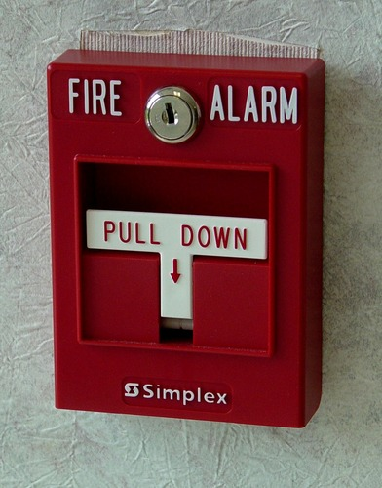
alarm system

Slide 3
burglar

Slide 4
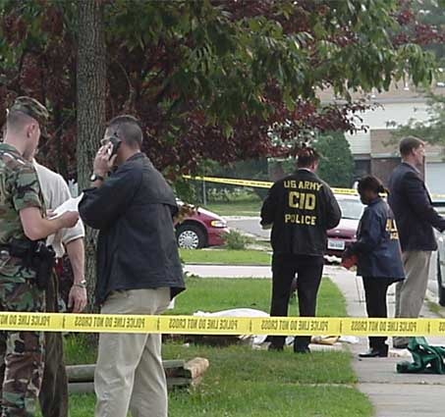
crime

Slide 5
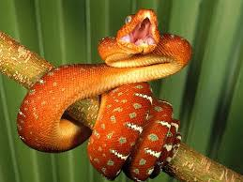
danger

Slide 6
peephole

Slide 7
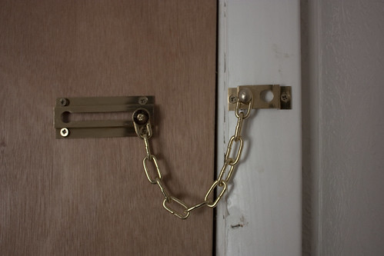
Door chain

Slide 8
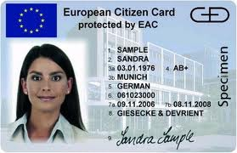
identification

Slide 9
What’s this?

Slide 10
Word formation
adjectives
adverbs
Careful внимательный
Real настоящий
Proper правильный -ly
Safe безопасный
Sure уверенный
Bad плохой
Carefully внимательно
Really по-настоящему
Properly правильно
Safely безопасно
Surely уверенно
Badly плохо

Slide 11
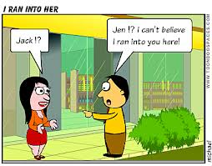
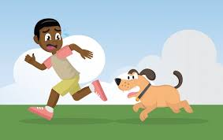
The phrasal verb “run”
Run out of – закончиться
Run into – случайно встретить
Run after – преследовать

Slide 12
Choose the preposition: (into, out of, after)
1.Sharon thought David was out of town, but she ran ______ him at the cinema.
2. We’ve run ______ sugar – I’ll go and buy some.
3. I ran _____the bus, but it didn’t stop for me.
4. We’ve run ______ petrol. We need to find a petrol station.
5. Guess what? I ran ______ Ivan at the library today.
into
out of
after
out of
into

