Slide 1
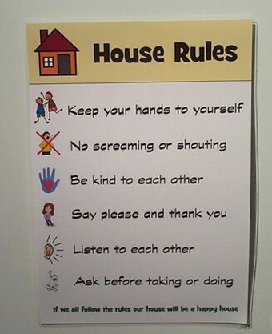
Spotlight 6 Lesson 8c
Rules

Slide 2
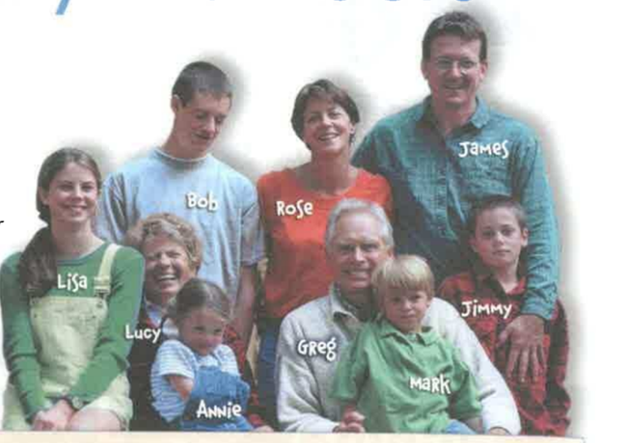
1. Rose is ……………… (young) than Lucy. (wb p.5) 2. Greg is ………………..(old) than James. 3. Annie is the …………………(young) of all. 4. Jimmy is the ………………………(serious) of all. 5. Lisa is …………...................(glamorous) than Bob.
younger
older
youngest
most serious
more glamorous
Practice your
grammar!
Your ideas?

Slide 4
Make your speech more natural! Use interjections!
Ah – фух! (облегчение, восторг)
Achoo – апчхи! (чихание)
Bless you! – будь здоров! благодарю!
Gee – вау! вот это да! (удивление, сюрприз)
Hmm – хмм, дай подумать!(нерешительность)
Hush – тсс! (просьба соблюдать тишину)
Oh – о! оу! (удивление, внезапность )

Slide 5
Make your speech more natural! Use interjections!
Oops - упс! ой! (внезапность, ошибка, неловкость)
Ouch - ай! ой! ауч! (боль, досада)
Pff - пфф! и что? (раздражение, разочарование)
Er - эмм (неуверенность, сомнение)
Well - ну ..., это .. (затягивание времени, сомнение)
Wow – ух ты! вау! круто! (удивление, восторг)
Yuck – фуу! (отвращение)
Yummy – мммм! вкусно! (реакция на аппетитное)

Slide 6
Practice!
1.(Gee/Hush/Well) The baby is sleeping.
Hush!
2. (Yummy/Achoo/Ah) I like this ice-cream!
Yummy!
3. (Oops/Hmm/Wow) We won the 1st prize!
Wow!
4. (Hmm/Ah /Yummy) The lesson is over!
Ah!
5. (Yuk/Gee/Er) Lima is … the capital of Pery.
Er

Slide 7
p.80 ex.1 Read and find out!
Who owns the room?
Mr Cox owns the room.
2. Who wants to rent it?
Daniel wants to rent it.

Slide 8
What are Mr Cox’s rules?

Slide 9
You mustn’t make noise.
You have to keep your room tidy.
You friends can come around only between 1pm and 9 pm.
They must be from students in this school.
You can’t bring food from the dining room.
You can only have snacks and soft drinks in your room.

Slide 10
Modals have to/don’t have to/needn’t
*have to (has to) – необходимо согласно обстоятельствам (приходится, должен)
Tom has to come to school at 8 a.m.
Тому приходится приходить в школу в 8 утра.
*don’t have to (doesn’t have to) – отсутствие необходимости (не нужно, не обязательно)
You don’t have to buy bread. I will do it.
Тебе не обязательно покупать хлеб. Я куплю.
*needn’t – не нужно, не стоит
You needn’t worry.
Тебе не стоит беспокоиться.

Slide 11
Workbook p.49 Check your answers
1
2. doesn’t have to
3. have to
4. needn’t
5. have to
6. have to
7. has to
8. have to

Slide 12
1. Where are the children? 2. What season is it? 3. What is the weather like? 4. What are the children doing? 5. What are they wearing?

Slide 13
p.80 ex.5 Use have to/ don’t have to/ needn/t. Study the example: We don’t have to(needn’t) wear uniforms.
wake up early | wear uniforms
keep the campsite clean | make our beds
 | do any cooking

Slide 14
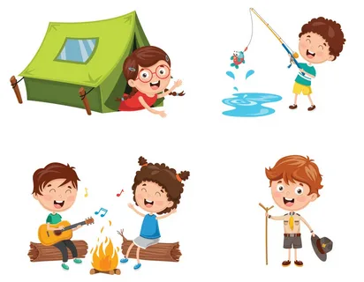
p.80 ex.6 Your are back from the campsite. Answer your friend’s questions. Work in pairs.
Did you wake up early?
Did you wear uniforms?
……………………….any cooking?
………………………the campsite clean?
……………………….your clothes?
…………………………swimming?
………………………..books?
…………………………fishing?
…………………………………… ? (your own question)
…………………………………… ? (your own question)

Slide 15
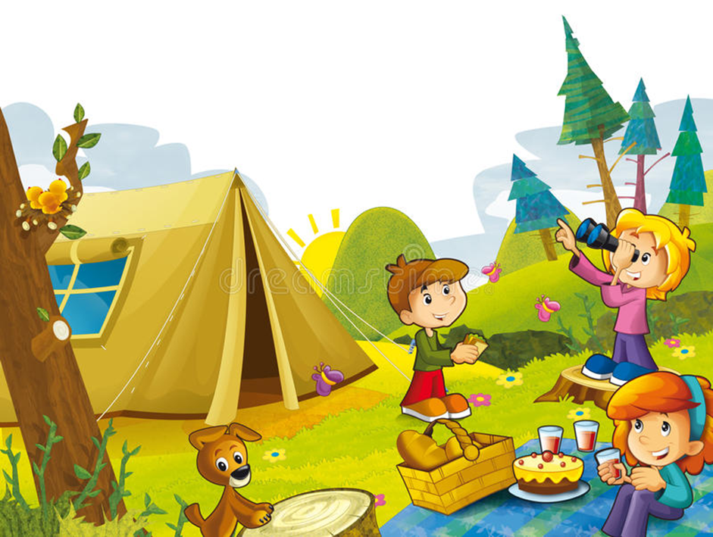
p.80 ex.7 Write summer campsite rules for kids!
To be a responsible camper :
You must listen to your camp councelor.
You must……………………
You must ………………….
4. You can’t ………..
But!
5. You don’t have to wear a uniform.
6. You don’t have to ………….
7. You needn’t ………….
8. You can ……….

