Slide 1
NATURAL DISASTERS
Natural disasters are catastrophic disasters that occur as a result of natural processes on the planet.

Slide 3
VOLCANO ERUPTION
A volcano is a mountain from which hot melted rock, gas, steam, and ash from inside the Earth sometimes burst.

Slide 4
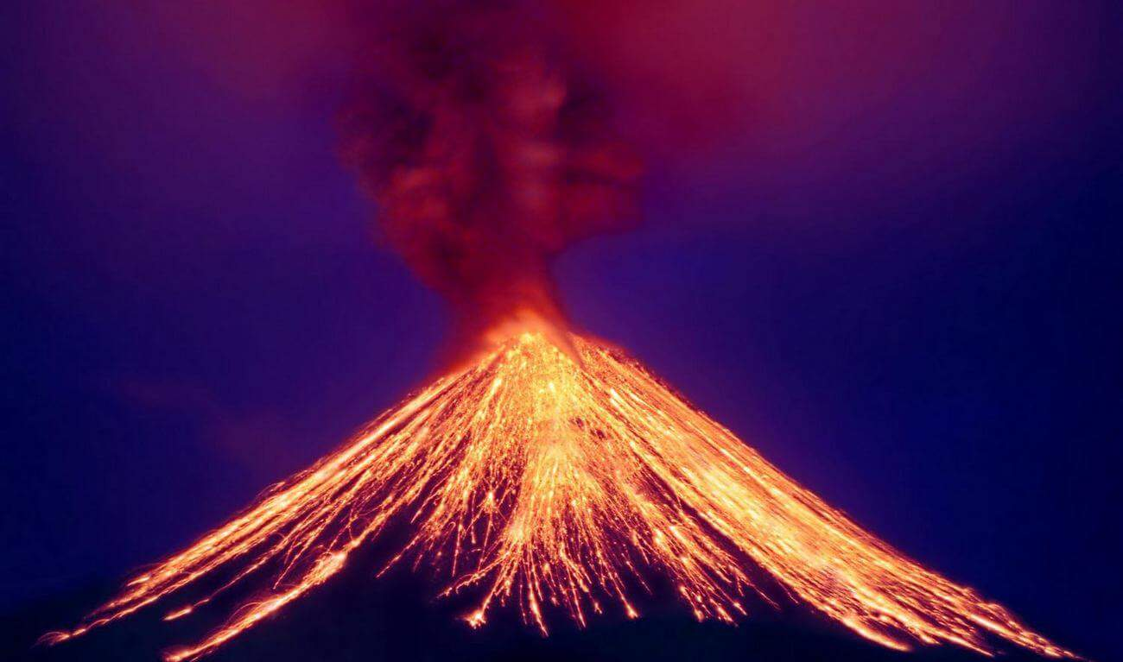

Slide 5
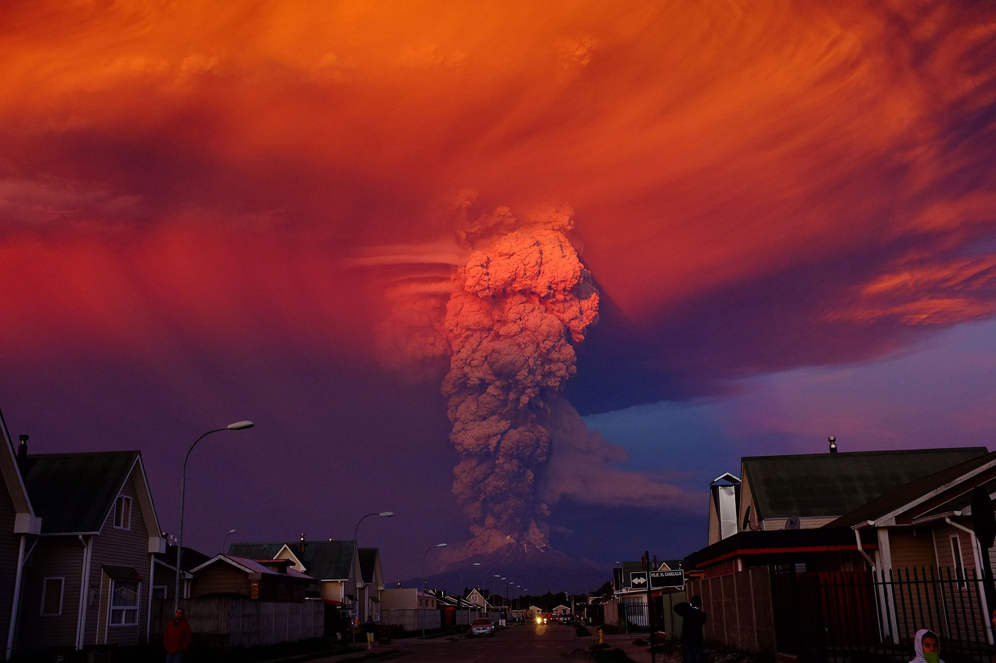

Slide 6
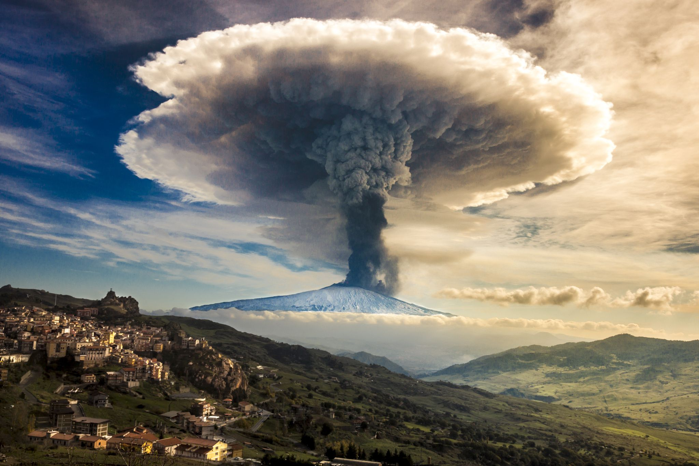

Slide 7
TSUNAMI
A tsunami is an enormous sea wave that erupts and reaches land.

Slide 8
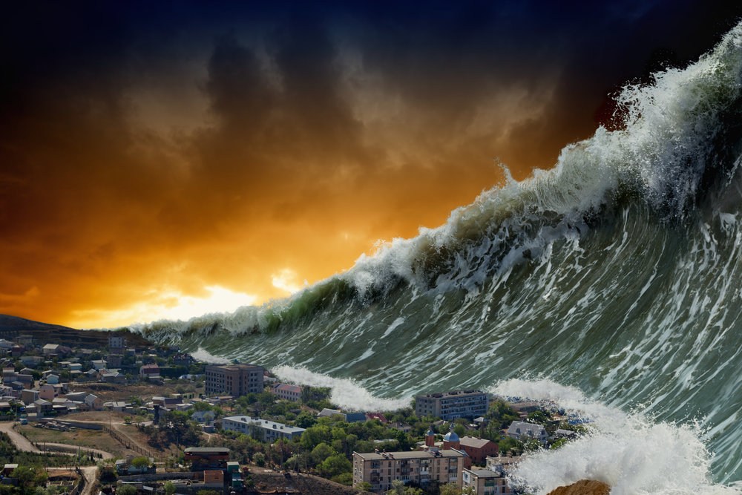

Slide 9
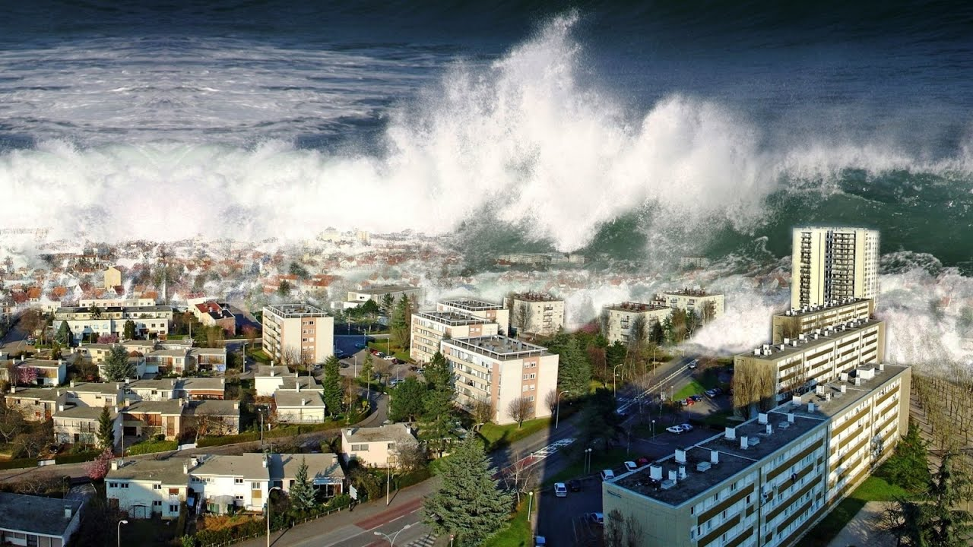

Slide 10
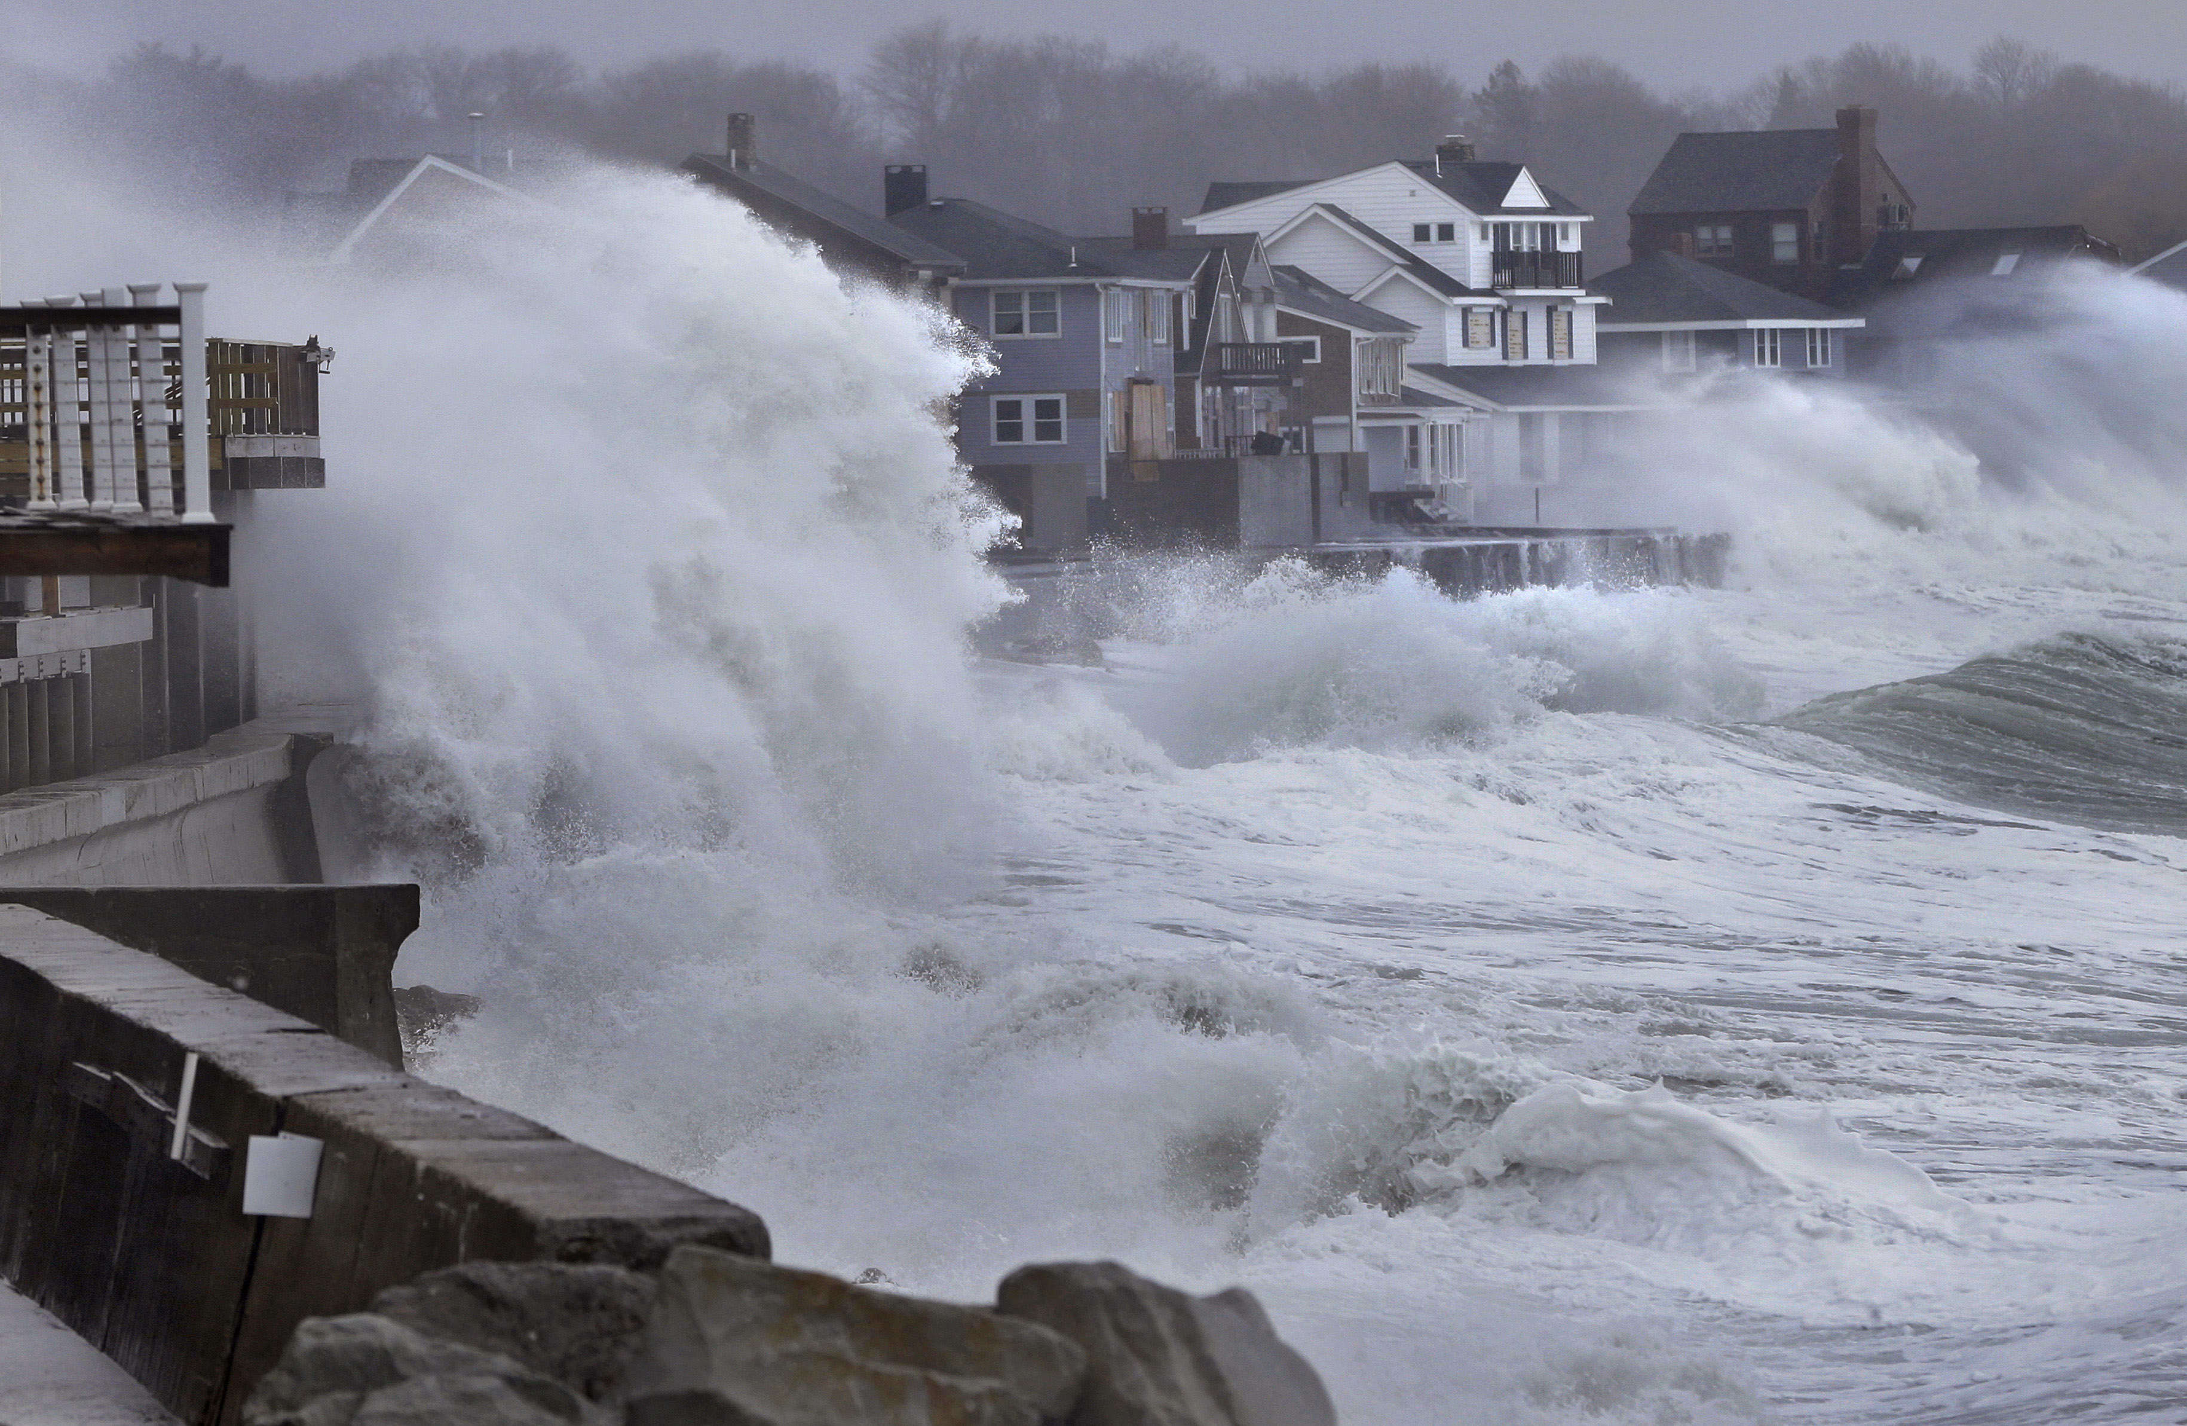

Slide 11
EARTHQUAKES
An earthquake is a sudden violent movement of the earth's surface, sometimes causing great damage.

Slide 12
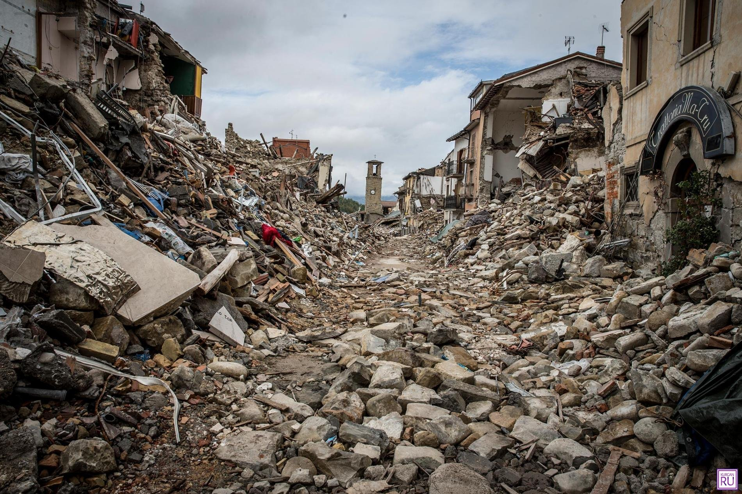

Slide 13
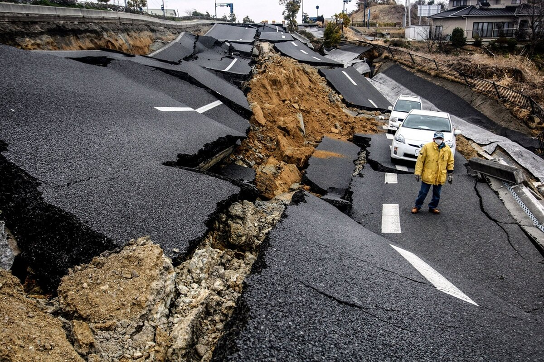

Slide 14
TORNADO
A tornado is a violently rotating column of air that is in contact with both the surface of the Earth and a cumulonimbus cloud or, in rare cases, the base of a cumulus cloud.

Slide 15
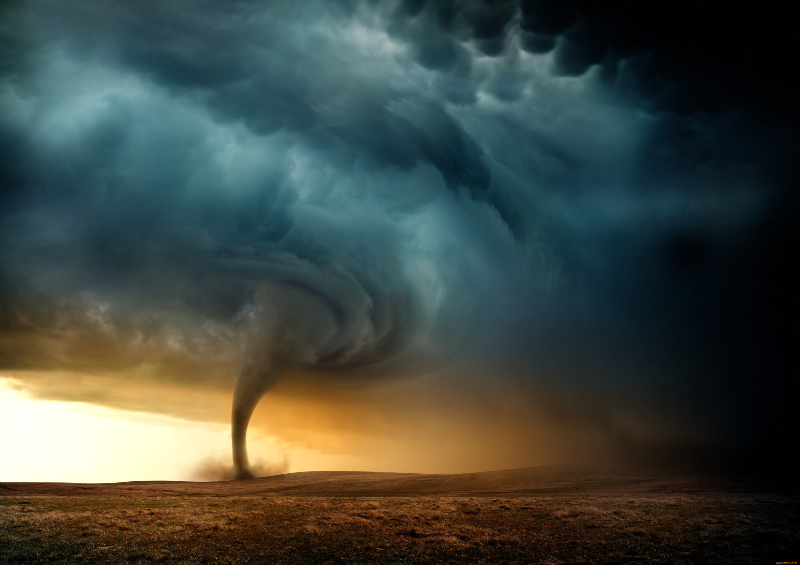

Slide 16
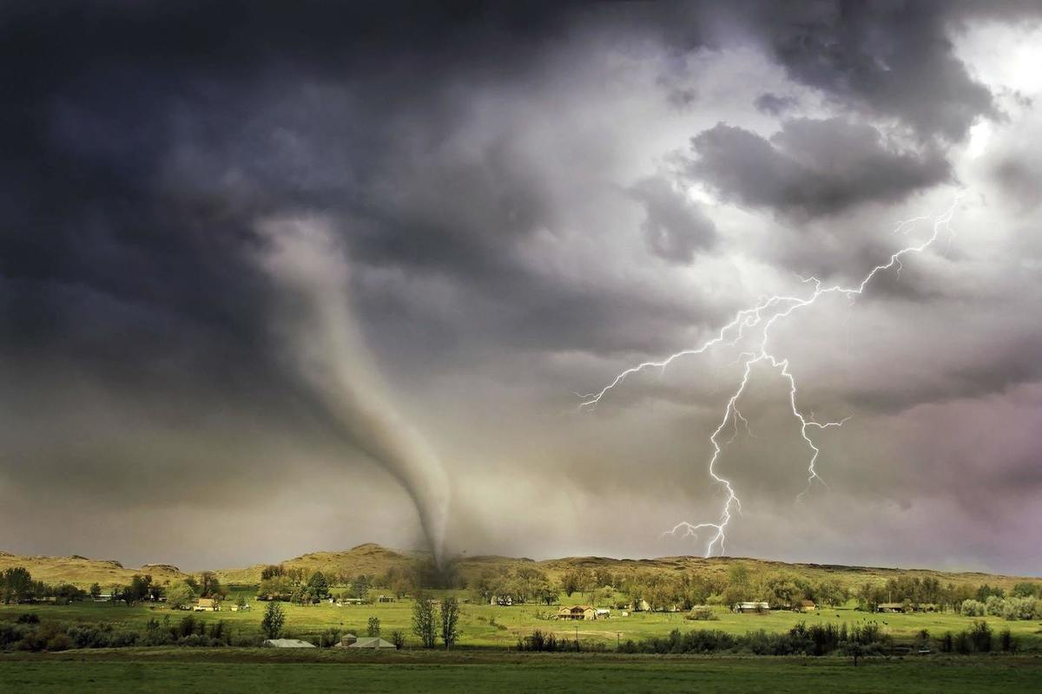

Slide 17
FLOODS
A flood is an overflow of water (or rarely other fluids) that submerges land that is usually dry. In the sense of "flowing water", the word may also be applied to the inflow of the tide.

Slide 18
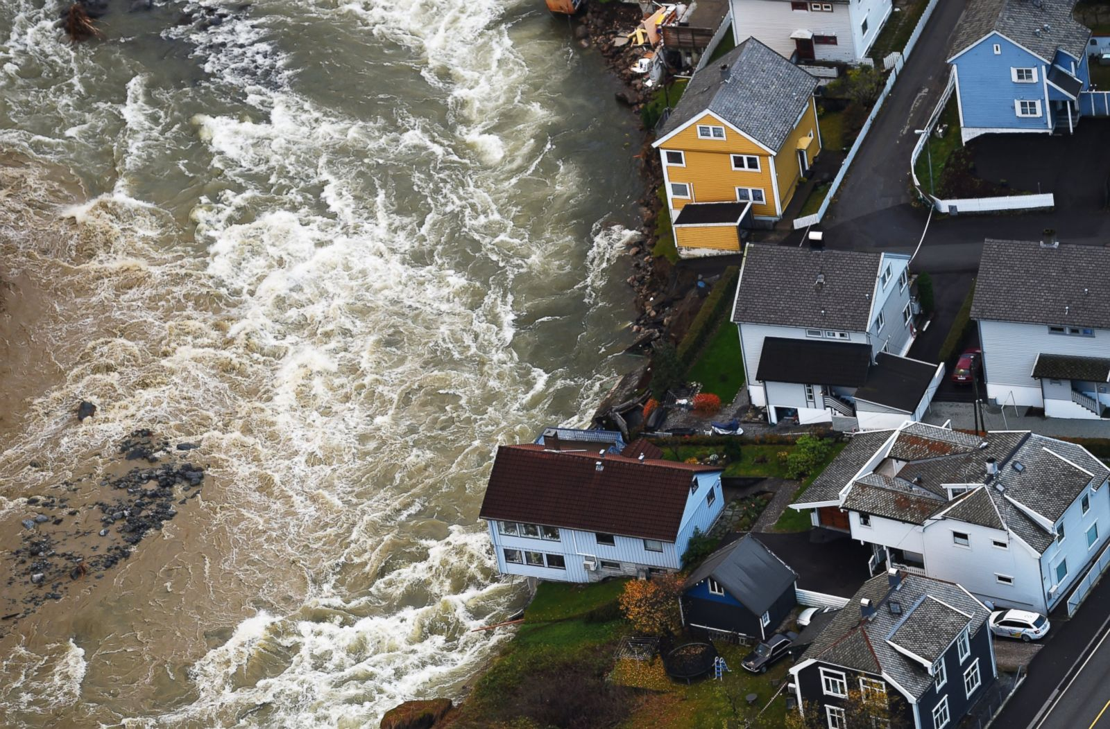

Slide 19
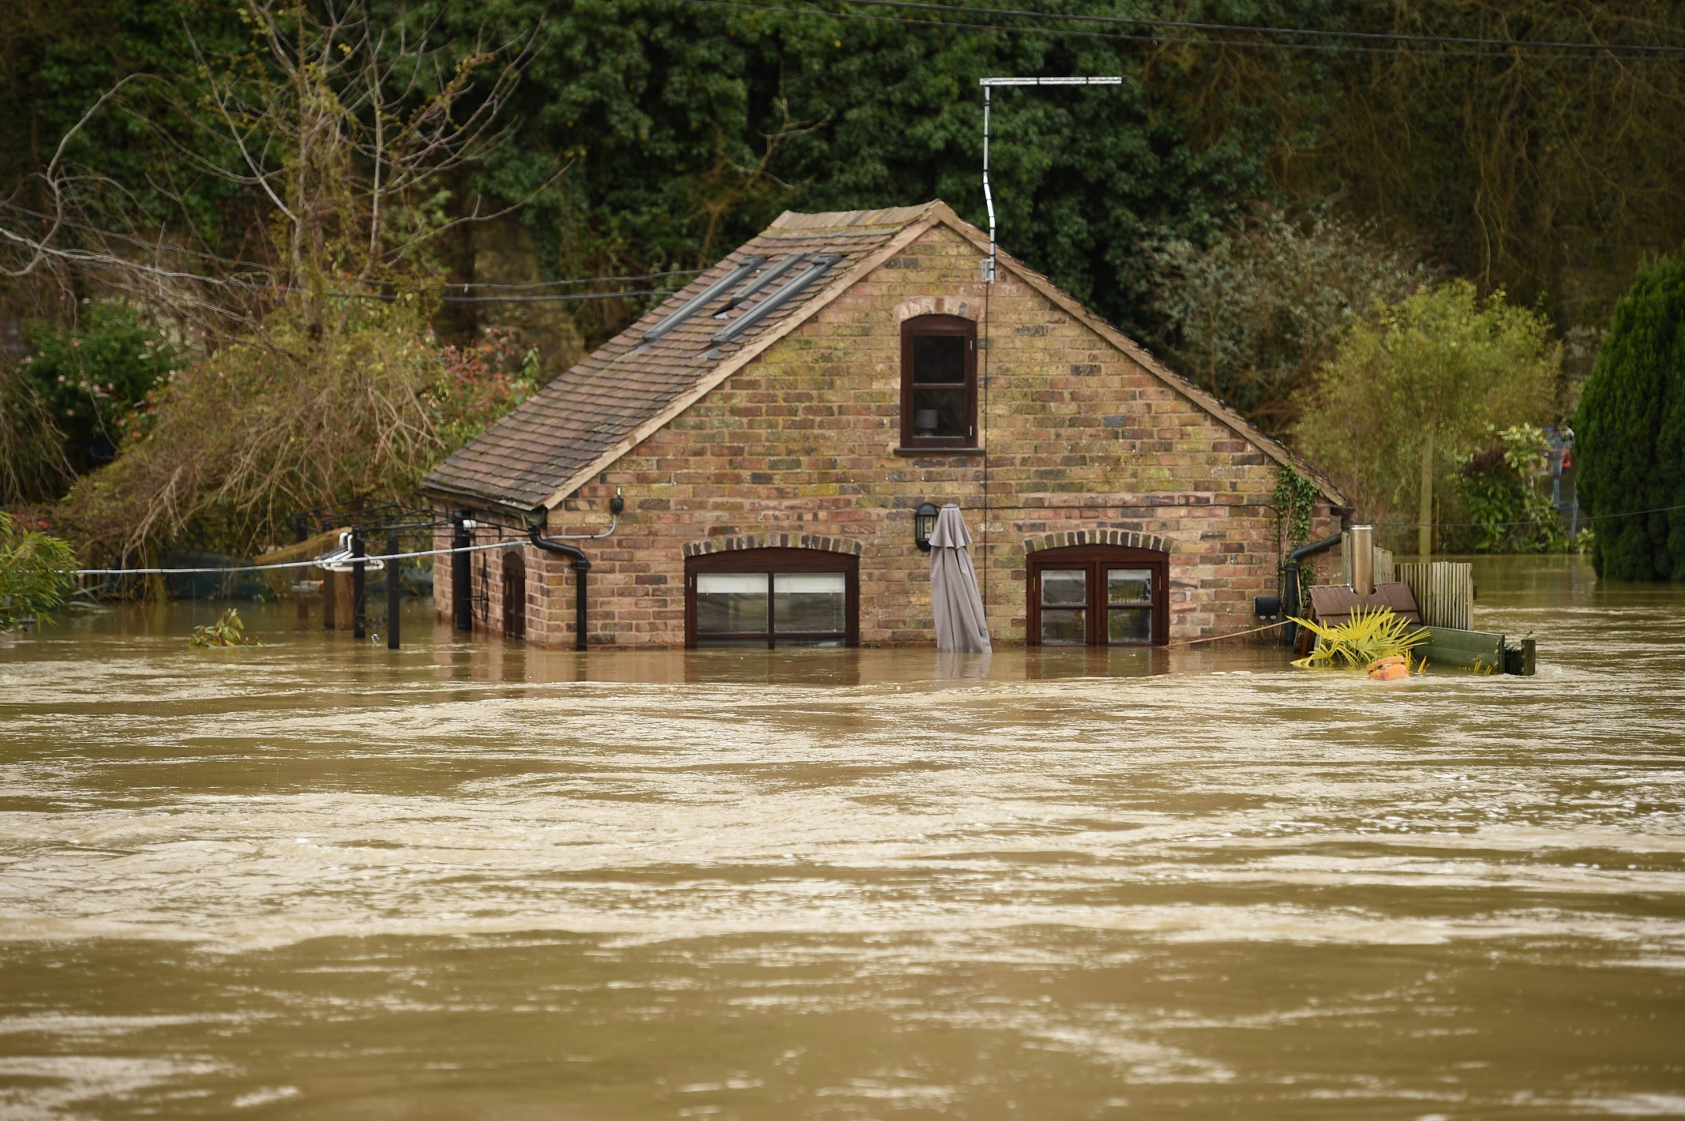

Slide 20
